Slide 1
Coffee Shop Sales Analytics & Business Intelligence
Data Storytelling & Statistical Validation Project
Presented by
Dinesh Kumar
14 May 2026

Slide 2
Business Objective
The objective of this project was to analyse coffee shop transaction data to identify customer behaviour patterns, sales trends, operational insights, and key business metrics that support data-driven decision-making.
Key goals of the project:
• Perform exploratory data analysis (EDA)
• Identify sales and revenue trends
• Analyze customer purchasing behaviour
• Define and track business KPIs
• Build an interactive business dashboard
• Generate actionable business insights

Slide 3
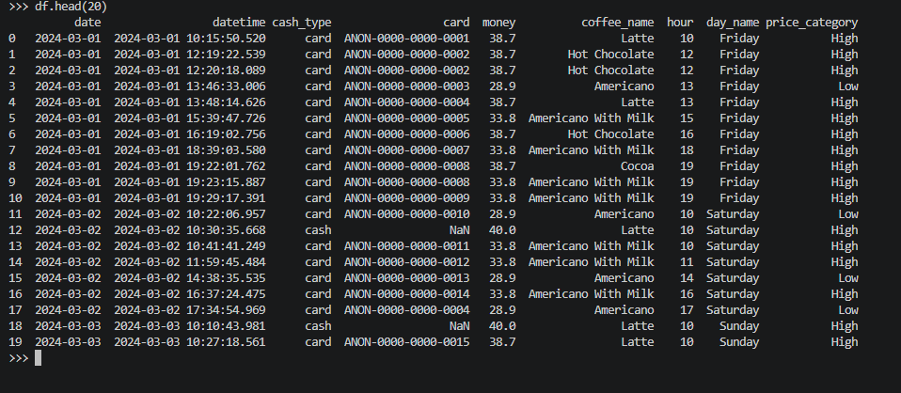
Dataset Overview
The objective of this project was to analyse coffee shop transaction data to identify customer behaviour patterns, sales trends, operational insights, and key business metrics that support data-driven decision-making.
Key goals of the project:
• Coffee shop transaction dataset
• Included purchase date and time
• Contained coffee product names
• Included payment methods
• Included transaction amount data
• Used for sales and trend analysis

Slide 4
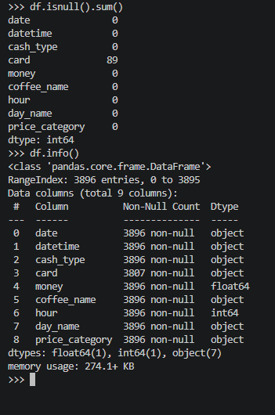
Data Cleaning & Transformation
Raw coffee shop transaction datasets were cleaned and transformed to improve data quality, consistency, and analysis readiness.
Data preprocessing tasks performed:
• Missing value assessment
• Duplicate detection and removal
• Date format standardization
• Text formatting cleanup
• Feature engineering
• Dataset merging and transformation

Slide 5
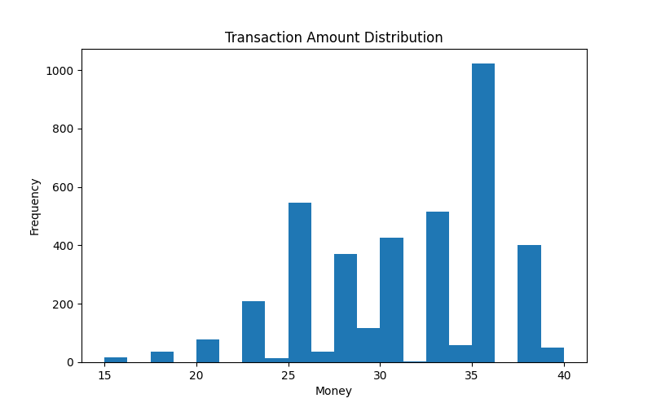
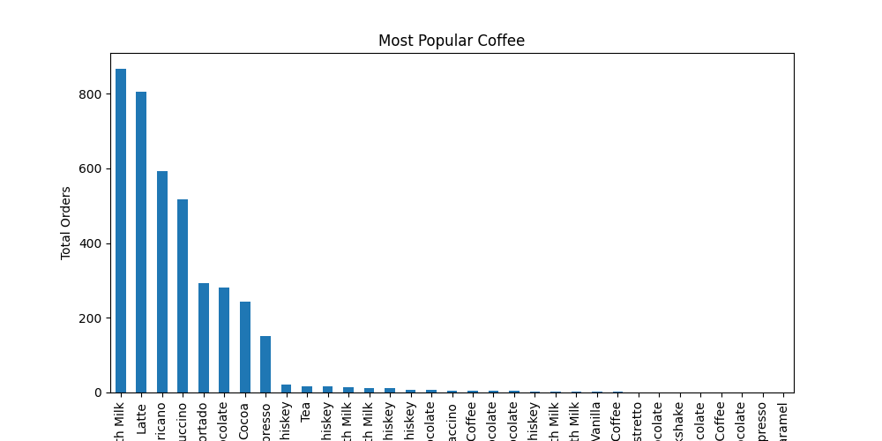
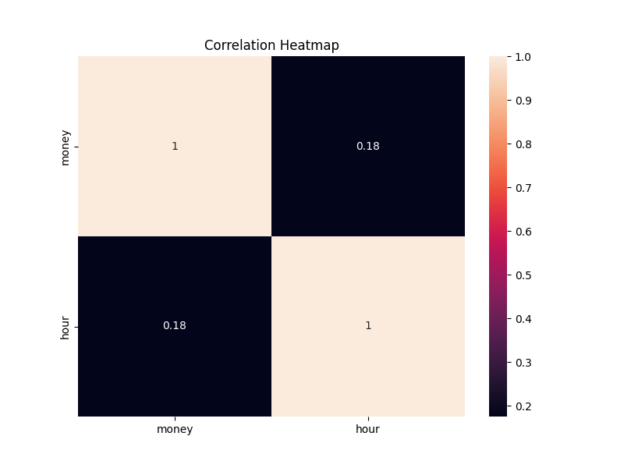
Exploratory Data Analysis
Exploratory Data Analysis (EDA) was performed to identify patterns, trends, customer behaviour, and relationships within the coffee shop transaction data.
Key Insights:
• Certain coffee products generated significantly higher revenue
• Transaction activity peaked during specific hours
• Revenue distribution varied across customer segments
• Customer payment preferences showed noticeable trends

Slide 6
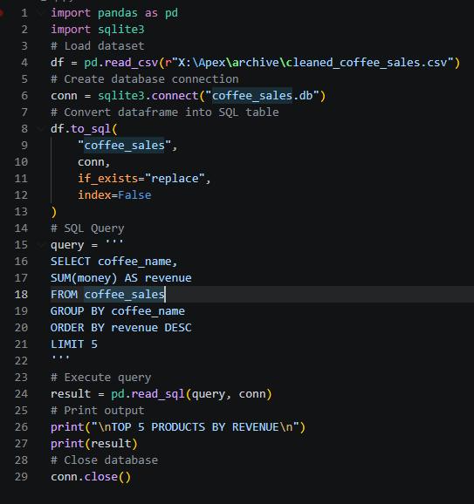
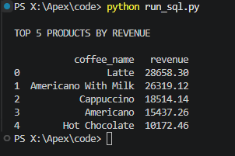
SQL Business Analysis
SQL queries were used to extract business insights related to revenue trends, product performance, customer behaviour, and transaction activity.
Key Insights:
• Certain coffee products contributed significantly to total revenue
• Specific hours generated higher transaction activity
• Payment method analysis revealed customer preferences
• Revenue patterns varied across products and transaction periods

Slide 7
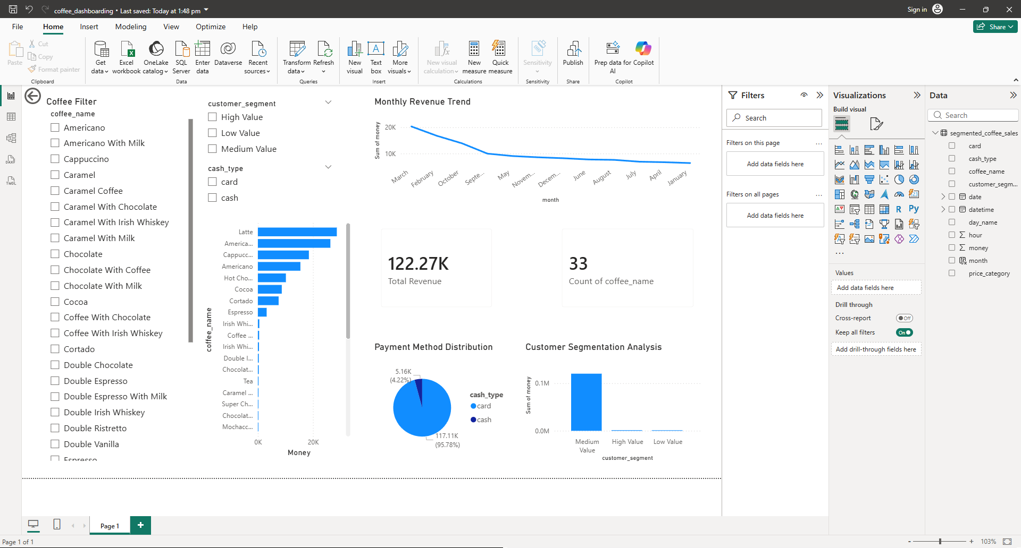
KPI Dashboard & Interactive Analytics
An interactive Power BI dashboard was developed to monitor key business metrics, analyze customer behaviour, and explore sales performance dynamically.

Slide 8
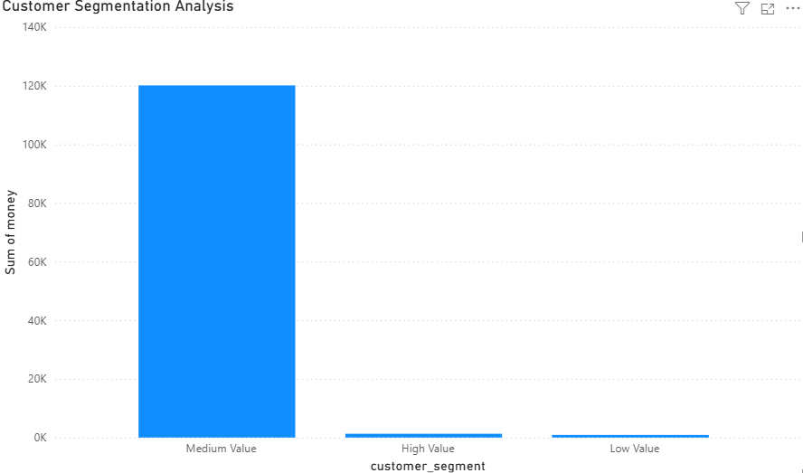
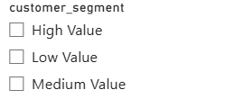
Customer Segmentation & Deep-Dive Analysis
A customer segmentation analysis was performed to categorize transactions into High Value, Medium Value, and Low Value customer groups based on transaction amount.
Key Insights:
• High-value customers contributed significantly to revenue
• Medium-value customers represented consistent purchasing behaviour
• Low-value customers showed smaller transaction amounts

Slide 9
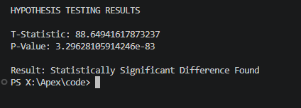
Hypothesis Testing & Statistical Validation
A customer segmentation analysis was performed to categorize transactions into High Value, Medium Value, and Low Value customer groups based on transaction amount.
Business Hypothesis
High-value customer transactions are significantly different from low-value customer transactions.
Statistical Method Used
A T-test was performed using Python to compare transaction amounts between customer segments.
Result
The analysis identified a statistically significant difference in spending behaviour between customer groups (p-value < 0.05).

Slide 10
Business Recommendations & Conclusion
Business Recommendations
• Focus promotional efforts on top-performing coffee products
• Increase staffing during peak sales hours
• Develop loyalty strategies for high-value customers
• Use dashboard monitoring for ongoing business tracking
• Analyze customer spending trends regularly for decision-making
Conclusion
The project successfully transformed raw coffee shop transaction data into actionable business insights through data cleaning, exploratory analysis, SQL querying, KPI dashboarding, customer segmentation, and statistical validation.
Thank You

